Slide 1
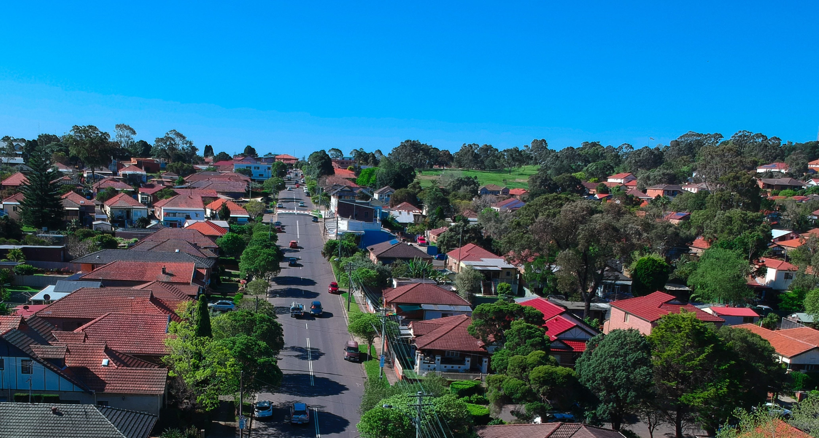
Rate peg review update
Country Mayors Assoc – 26 May 2023
Carmel Donnelly PSM, IPART Chair

Slide 2
Review timeline
Terms of Reference
30 Aug 2022
Issues Paper
29 Sep 2022
Workshops
Nov / Dec 2022
Technical workshops
and ratepayer focus groups
April 2023
Draft Report
Early June 2023
Public Hearing
June 2023
Final Report
August 2023

Slide 3
Consultation so far
96
submissions to our
Issues Paper
11
stakeholder workshops
2,881
respondents to resident/ratepayer survey
Meetings eg CMA meeting Nov 2022
Information provided by stakeholders
515
respondents to business ratepayer survey
44
ratepayer focus groups
(Plus: over 1800 submissions on 17 concurrent SV applications)

Slide 4
Council feedback
Many advocated for abolishing the rate peg
Current rate peg/SV model not supporting council financial sustainability
Build on & align with IP&R
Labour cost changes should be based on the NSW LG (State) Award
Rate peg does not accurately reflect changes in asset costs
Include costs driven by external changes, outside of councils’ control
Diversity of councils and their ratepayer communities
Remove productivity factor or keep at zero & adjust population factor
ESL and red fleet issues

Slide 5
Ratepayer submissions
Affordability & cost of living
Councils’ financial management and efficiency
Council spending should reflect community preferences/priorities
Rate peg has not helped ratepayers enough (large special variation increases, individual rate increases, cross-subsidies via exemptions)
Support for keeping the rate peg
Why is the rate peg not based on CPI?
Population factor – prison populations

Slide 6
Early findings: residential ratepayer survey
ORIMA Research surveyed 2,881 residential ratepayers and renters across NSW.
Affordability of rates is the most important consideration.
Respondents generally have positive views about the services provided by their council.
Two thirds preferred for councils’ rates to change by different amounts to suit their needs.
Ratepayers and community should have a high level of influence in deciding council rate increases.

Slide 7
OLG, LGNSW & council technical workshops
Separate factor based on individual council increases
New measure: 3 factor index
Strengthen and tailor
Rate peg
Change in base costs
Population factor
Other adjustments
Productivity factor
ESL factor
3 council groupings
Revision suggestions
Remove or retain at zero

Slide 8
Key options as we prepare draft report
More timely, accurate cost measurement – Labour, assets, other costs
Council groupings
Separate ESL factor based on actual y-o-y increase per council
Minor adjustment to the population factor
Productivity factor remaining at zero
Costs driven by external changes, outside of councils’ control, to be captured by strengthened tailored adjustment factor
Regular review of method plus implementation reference group
Wider issues raised by stakeholders - more work needed

Slide 9
Next steps
Further consultation
Terms of Reference
30 Aug 2022
Issues Paper
29 Sep 2022
Workshops
Nov / Dec 2022
Technical workshops,
surveys
and ratepayer focus groups
Jan- April 2023
Draft Report
Early June 2023
Public Hearing
June 2023
Final Report
August 2023

Slide 10
Discussion
Review of the rate peg methodology | IPART (nsw.gov.au)

